Slide 1
Welcome to Parent Council
In the spirit of Thanksgiving…please find a seat and take a moment to write a “Thank you” to someone at Holicong, CB…or anywhere…and we will make sure he or she receives it!

Slide 2
How we want students to feel…

Slide 3
HOLICONG STUDENT ACTIVITIES, STAFF WELLNESS,
and COMMUNITY PARTNERSHIPS…
What Have We Done?

Slide 4
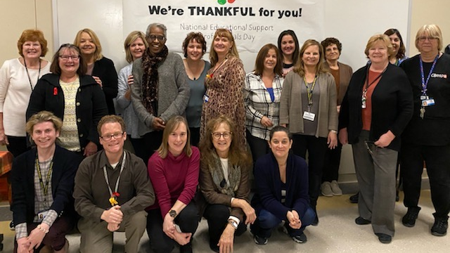
SUPPORT STAFF APPRECIATION DAY

Slide 5
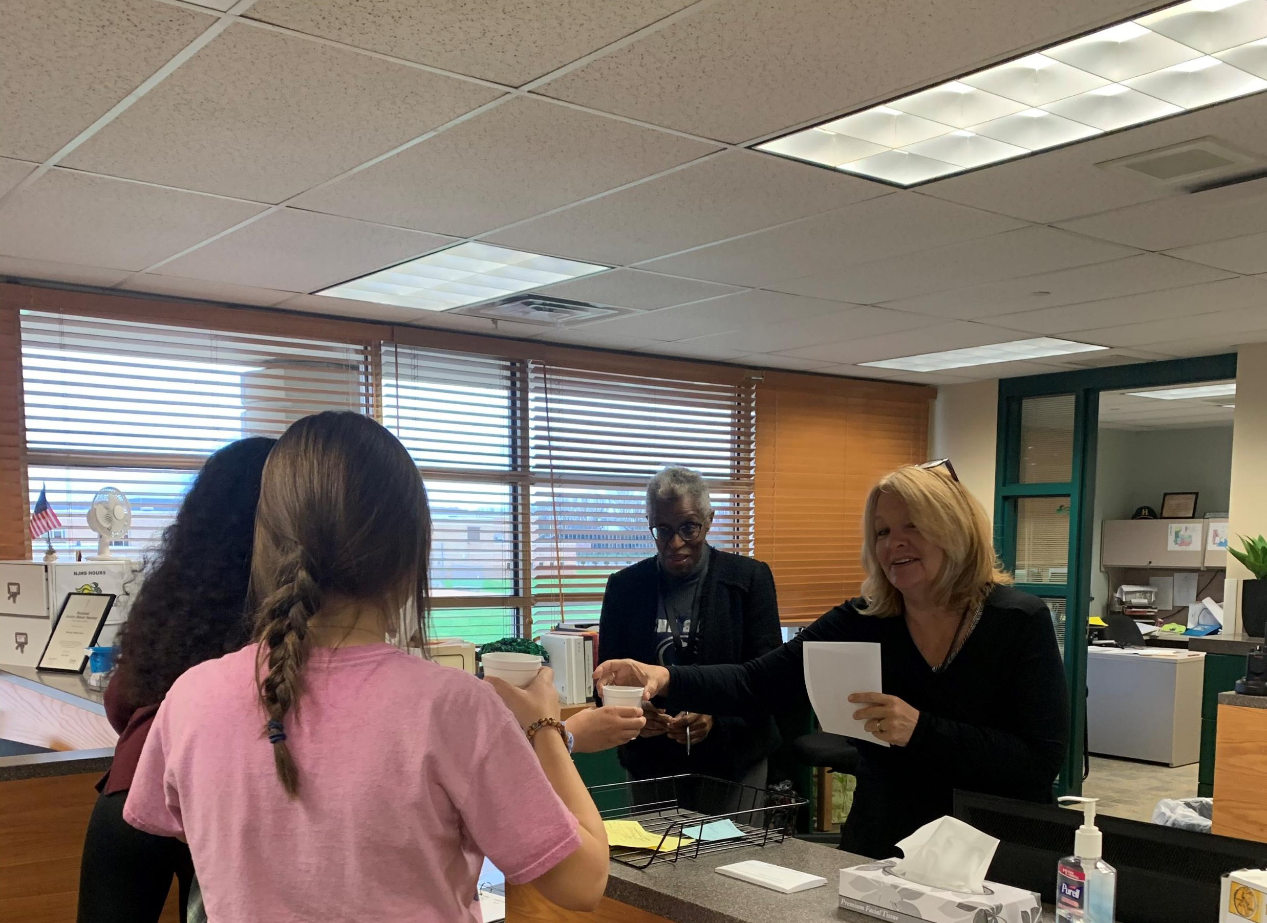
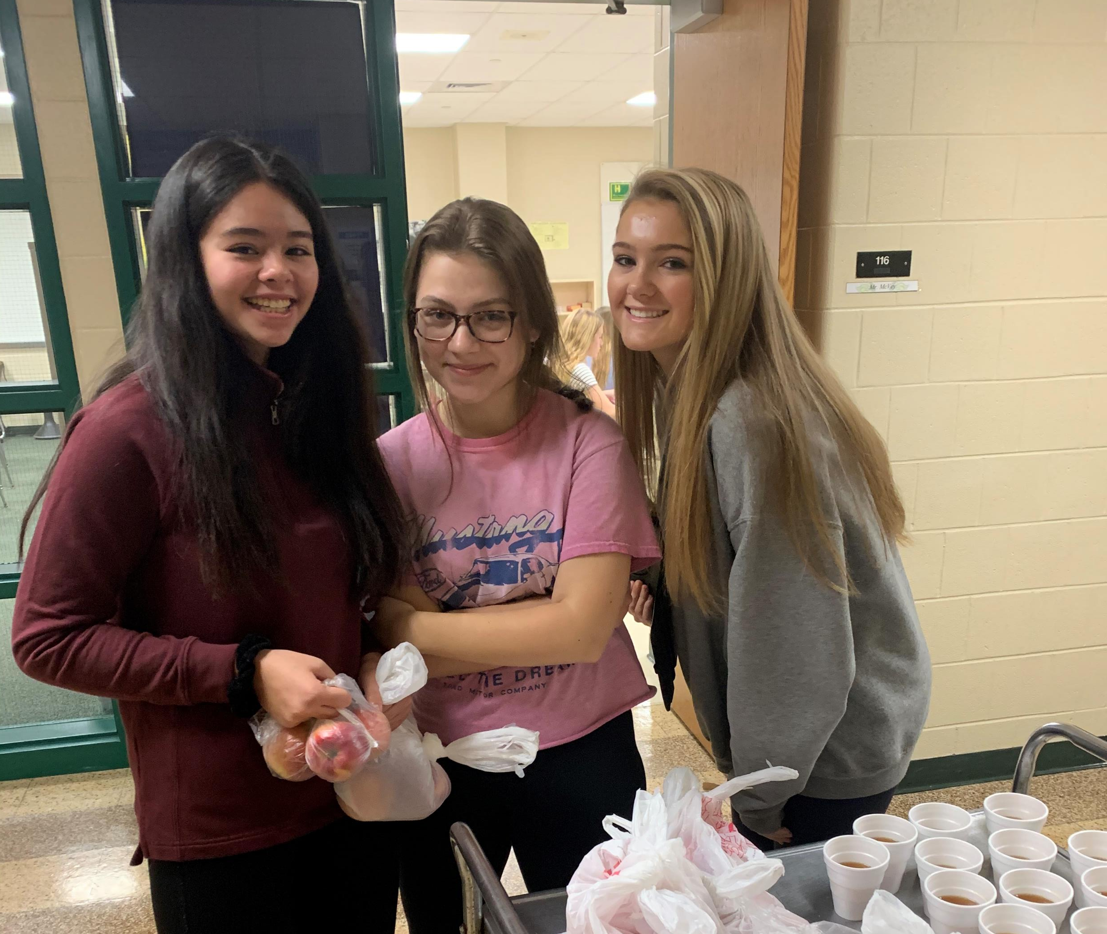
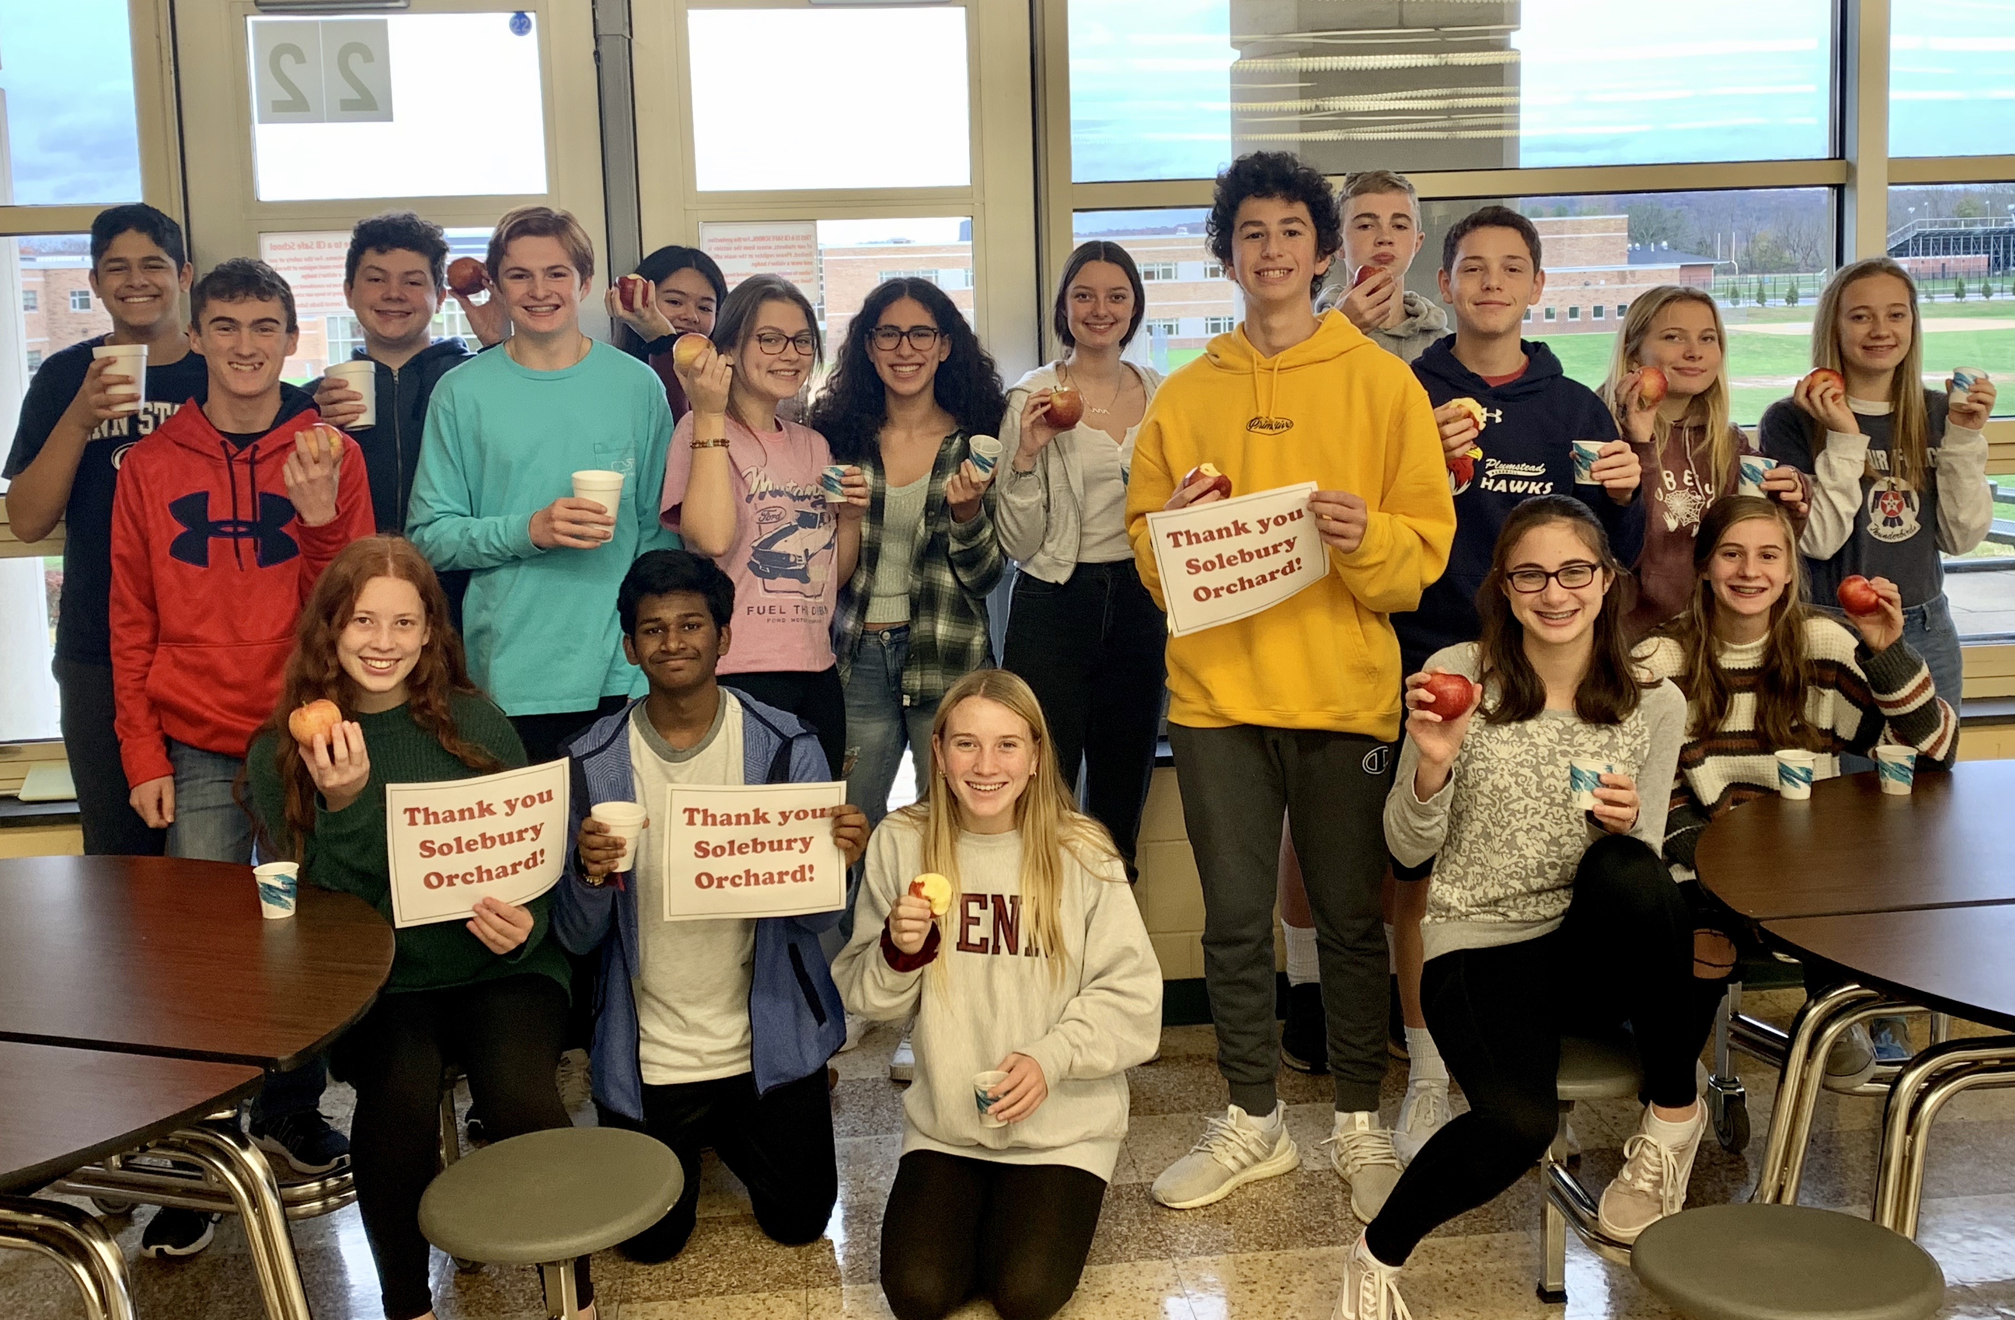
STUDENT LEADERSHIP Staff Appreciation
THANK YOU SOLEBURY ORCHARDS

Slide 6
Treats for Troops! Over 400 pounds delivered!

Slide 7
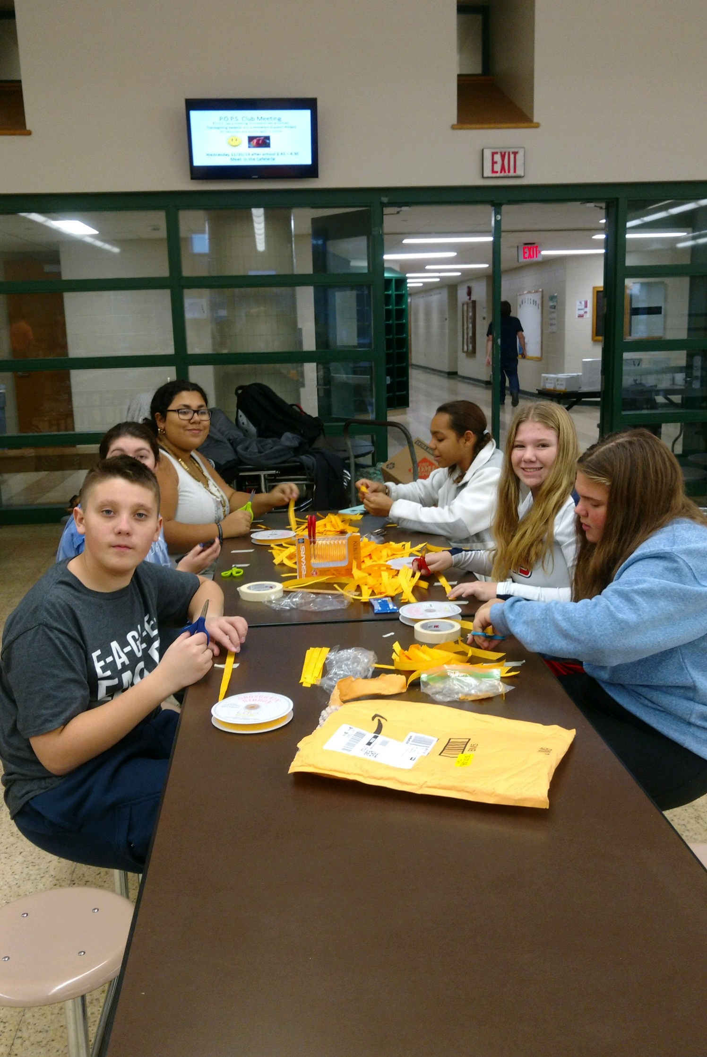
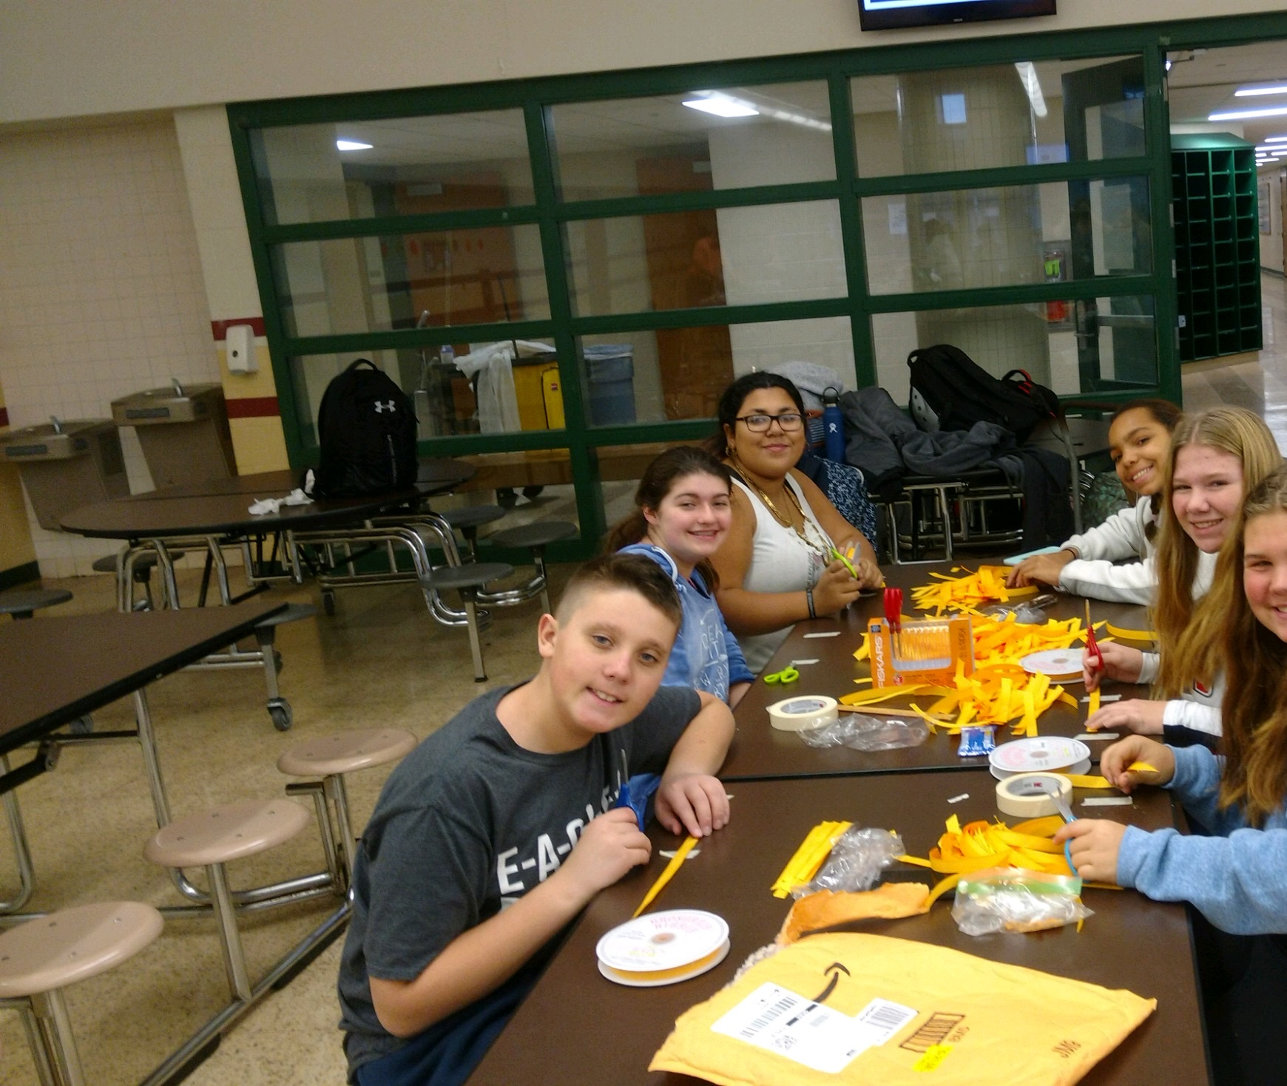
Power of Positive Students & Peer Connect
Thanksgiving Baskets & Homeless Shelters

Slide 8
HOLICONG STUDENT ACTIVITIES, STAFF WELLNESS,
and COMMUNITY PARTNERSHIPS…
What Are We Doing?

Slide 9
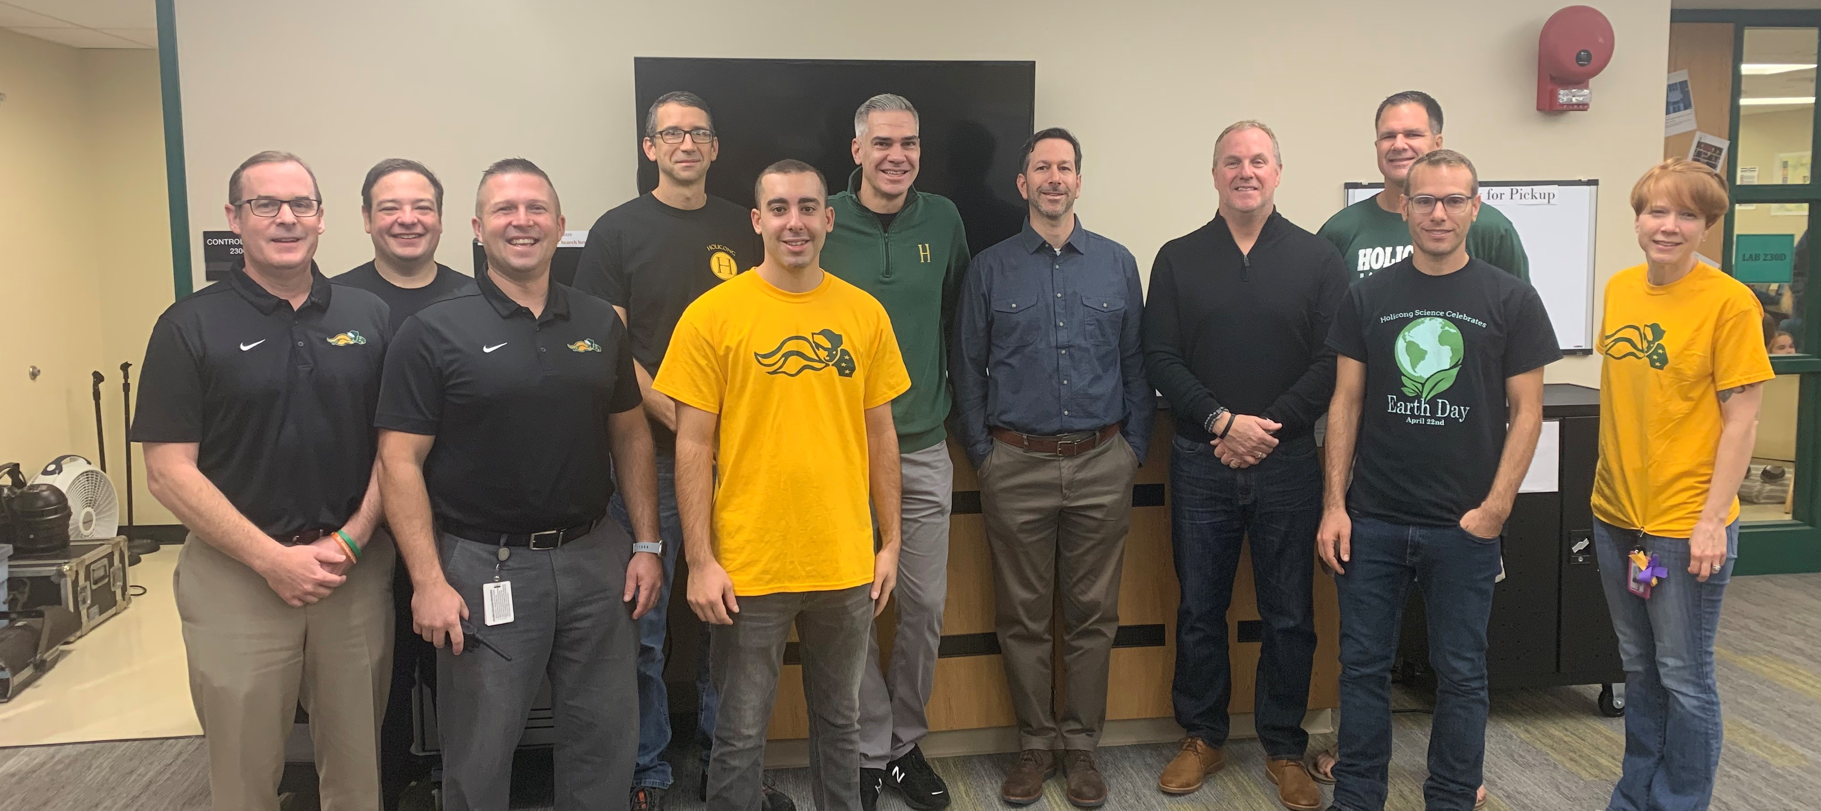
Who? Holicong staff members
What? Students and staff will donate money into jars or online for who they wan to have the wackiest beard.
Teachers will shave their beards into a whacky beard depending on the amount of money raised at the end.
When? November 1st- 25th
Why? To raise money for Pennies for Patients
Special Thanks to Holicong Parents for Joining!
John Rawluk – (Avery McCann) Dan Stevens – (Edgar Stevens) Thomas Simkiss – (TJ, Logan and Connor)
Scott Berger – (Justin)

Slide 10
TOYS for TOTS
Please welcome…
Dhruv Mukund
&
Sienna Valeni

Slide 11
Collection Room:
Tech Ed - Room 119
New, unwrapped toys
Now until December 9th only
Every gift which is given, no matter how big or small, is in reality great, if it is given with affection.

Slide 13
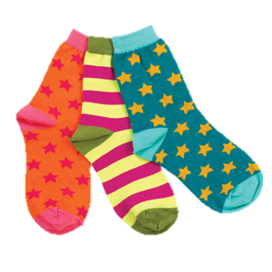
Share the Glove
Warm hands and toasty toes this winter!
Accepting all donations, but new socks, gloves, and mittens are especially appreciated
Drop off donations in the box by the bus loading platform before winter break

Slide 14
HUMANITARIANS OF HOLICONG
Please welcome…
Jacob Chavez, Brooke Dougherty & Ella Moore

Slide 16
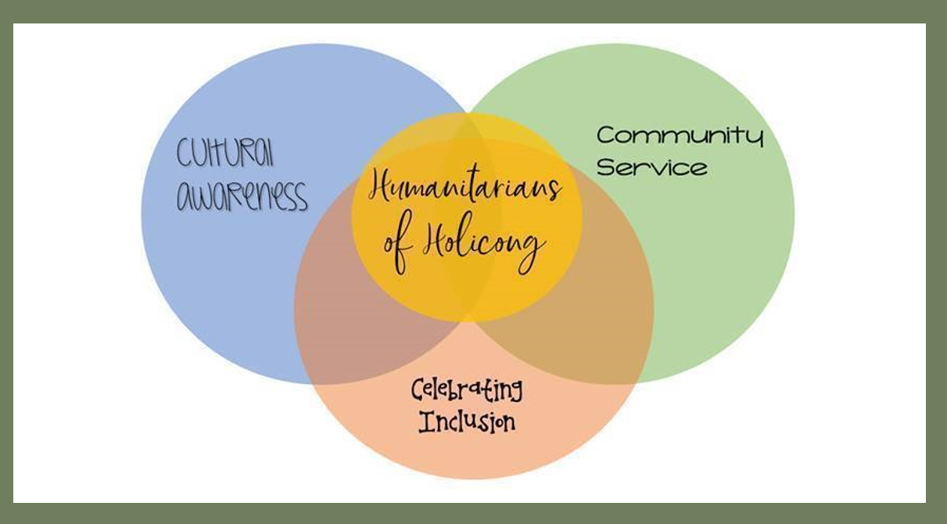

Slide 19
Thoughts to consider…
How can the community help us?
What else can we do to meet our goals?
See our new project…Morning Show - Faces Go Places.docx

Slide 20
CURRICULUM SPOTLIGHT Math Department
Please welcome…
Mrs. Farrell

Slide 21
What’s new in the math department?

Slide 22
New books, new courses:
Algebra 1 and Algebra 1A
To ensure students have every opportunity to reach mastery.
Time built in for remediation and enrichment.
Changes will eventually be made in each course.

Slide 23
Every student has access to IXL
Questions and problems for every topic of study in every math course.
Built-in remediation and enrichment.
Students practice a topic to mastery (“Smart Score”).
ixl.com

Slide 24
CBSD SUCCESS PLAN
Please welcome…
Mrs. Louderback

Slide 25
Chapter 339/K12 Guidance Plan Success Plan
Notes:
Today, I’m going to briefly share some information about these three topics, all of which relate to your students preparing for life after high school. In recent years, PDE has required each school to have a K-12 Guidance Plan under Chapter 339. The Success Plan (formerly known as the Career Plan) is one of the ways we meet the required mandates by the state. Naviance is one component of the Success Plan.

Slide 26
INTRODUCTION
Meet the requirements of PA Chapter 339 regulations.
Create a comprehensive K12 Guidance Plan.
Incorporate curriculum to meet the standards of the PA Career Readiness through Indicators.
We are required by the state to submit 20 Indicators K through 11th grade.

Slide 27
MISSION STATEMENT – K12 Guidance Plan
Our mission will provide a comprehensive, developmental counseling program which facilitates the academic, social/emotional and career needs of all our students with equal access and equity. With the cooperation of our Educators, Parents, Community Members, Local Businesses and Post-secondary Institutions, the aim is to empower students to reach their full potential as responsible citizens and life-long learners.

Slide 28
CAREER READINESS STANDARDS
Career Awareness and Preparation
Career Acquisition
Career Retention and Advancement
Entrepreneurship
Notes:
PDE mandates that we meet Career Readiness Standards in each grade level. These standards fall under these four headings.

Slide 29
MOVING FORWARD – K12 Guidance Plan
8th Grade: I can list ten careers that match my interests and abilities. (Career Awareness)
9th Grade: I have completed a cover letter. (Career Acquisition)
10th Grade: I can give three examples of time management strategies which help me at school and/or on the job. (Career Retention)
11th Grade: I have compared working in the corporate environment with starting my own business in order to achieve career goals. (Entrepreneurship)
How do we improve our work in these areas? We can do this through our implementation of the “I” statements in our curriculum every day, with our conversation with students, parents and each other.
Notes:
What skills do you need to be successful rather than “where are you going to college?” On this slide, you will see examples of how we can identify whether students have mastered these standards.

Slide 30
K12 PLAN ADVISORY COUNCIL
This October we will conduct our first meeting of the K12 Plan Advisory Council which is made up of 20 stakeholders including students, parents, educators, and post-secondary and community partners. They will review the K12 Plan to offer feedback and suggestions. This group is a required component and will continue to meet twice a year for ongoing support.

Slide 31
Success Plan Implementation
There are 4 – 5 tasks each year in grades 7 – 12.
These tasks are to be completed in advisory.
There will be an online module where you will learn about what your Advisory grade level students will be doing. All Success Plan materials for teachers will be located on the Intranet.
All Success Plan materials for parents and students will be located on the Internet.
Advisory teachers will review student work and enter completion into Infinite Campus.
Advisory teachers will enter PRO or NYP for each task.

Slide 32
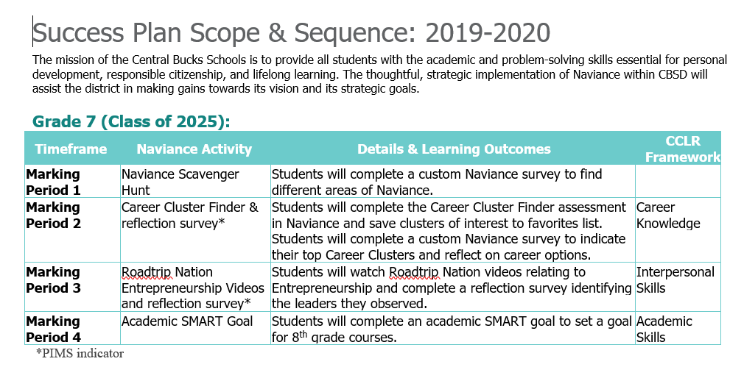
Notes:
This is a screenshot of the scope and sequence.

Slide 33
NAVIANCE
Please welcome…
Madame Del Rosario

Slide 34
Career Success Plan
Previous Years
Graduation Project
2018-2019
Naviance
2019-2020
Naviance
Naviance
Career Plan 10th-12th
Career Plan 9th – 12th
Success Plan 7^{th –} 12th
Notes:
We are rebranding the Career Plan to be called the Success Plan because we think that more clearly relates to K-12 needs.

Slide 35
Naviance

Slide 36
What is Naviance?
Naviance is an American college and career readiness software provider that partners with high schools and other K–12 institutions to provide students with college planning and career assessment tools. The company reports that its products reach more than 7 million students at nearly 8,500 schools in 100 countries.

Slide 37
Let’s glance at Naviance!

Slide 38
CBSD SCHOOL START TIMES COMMITTEE
Please welcome…
Mrs. Matich

Slide 39
CBSD SCHOOL START TIMES COMMITTEE
Website

Slide 40
Holicong Parent Council
November 21st, 2019

